Slide 1
Effects of COVID-19 on the homeless population in the state of California
By DFT (Racheal, Elijah and Mark)

Slide 2
Racheal
Bachelors degree in Biology from UMass Boston
I am a Lab Technician that specializes in Plasmid DNA extractions.
I don’t know how I got here, I just followed the will of God for my life.
Free time? What free time?: I like to take naps, teach kids at church, sing and dance.
Favorite fruit is watermelon

Slide 3
Elijah
AS in science from New Mexico Military Institute
I am a CNC machine operator for Sauer Machining LLC
I am an avid reader and podcast listener and love to go in-depth in to the newest technologies and fields as well as a good Tolkien novel.
Peach_ specifically my hometown Fredericksburg peaches

Slide 4
Mark
Senior year in computer and information science BS oversees.
IT Support Engineer for the past 4 years. Prior to the covid shutdown, I worked for PCC Structurals Inc which specializes in Jet Engine Manufacturing world widely and I was one of the people responsible for 2 big manufactures.
I enjoy playing the piano and worship God with it in my free time, get together with my friends on the weekend. We hang out, watch movies and play games. So much fun.
I adore bananas. I’m known by “The king of bananas” among my friends and family. The sweetest fruit on the plant that everybody loves.

Slide 5
Project introduction ? Background
What is COVID-19
What are the impacts of COVID-19 to the world in General
Why we chose California

Slide 6
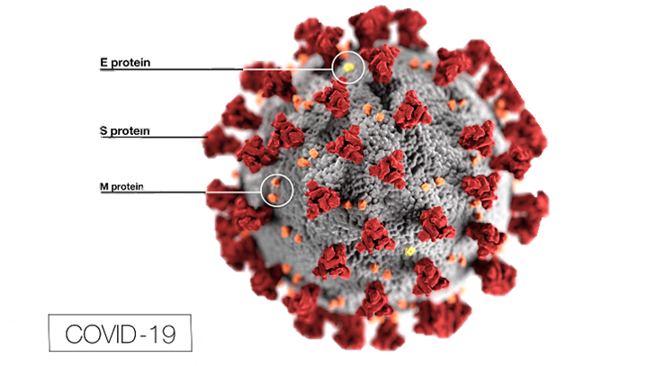
What is COVID-19
COVID-19 is caused by a coronavirus
WAIT!! What is a coronavirus?
Coronaviruses are viruses that are name fir the crown-like spikes on their surfaces.
There are coronaviruses that cause disease in humans and in animals.
Sometimes animal corona viruses evolve and become a new human coronavirus.
For example SARS from 2003 and now COVID-19

Slide 7
What is COVID-19
It is caused by a novel coronavirus, named Severe Acute Respiratory Syndrome coronavirus 2 (SARS-CoV-2).
It was identified as the cause of an outbreak of respiratory illness first detected in Wuhan China in 2019.
The illness caused by the virus has been named coronavirus disease 2019 (COVID-19).

Slide 8
What is COVID-19
SARS-CoV-2 is presumed to have been transmitted through bats, but this has not been confirmed. So the origin is still unknown
There is currently no vaccine for coronaviruses.

Slide 9
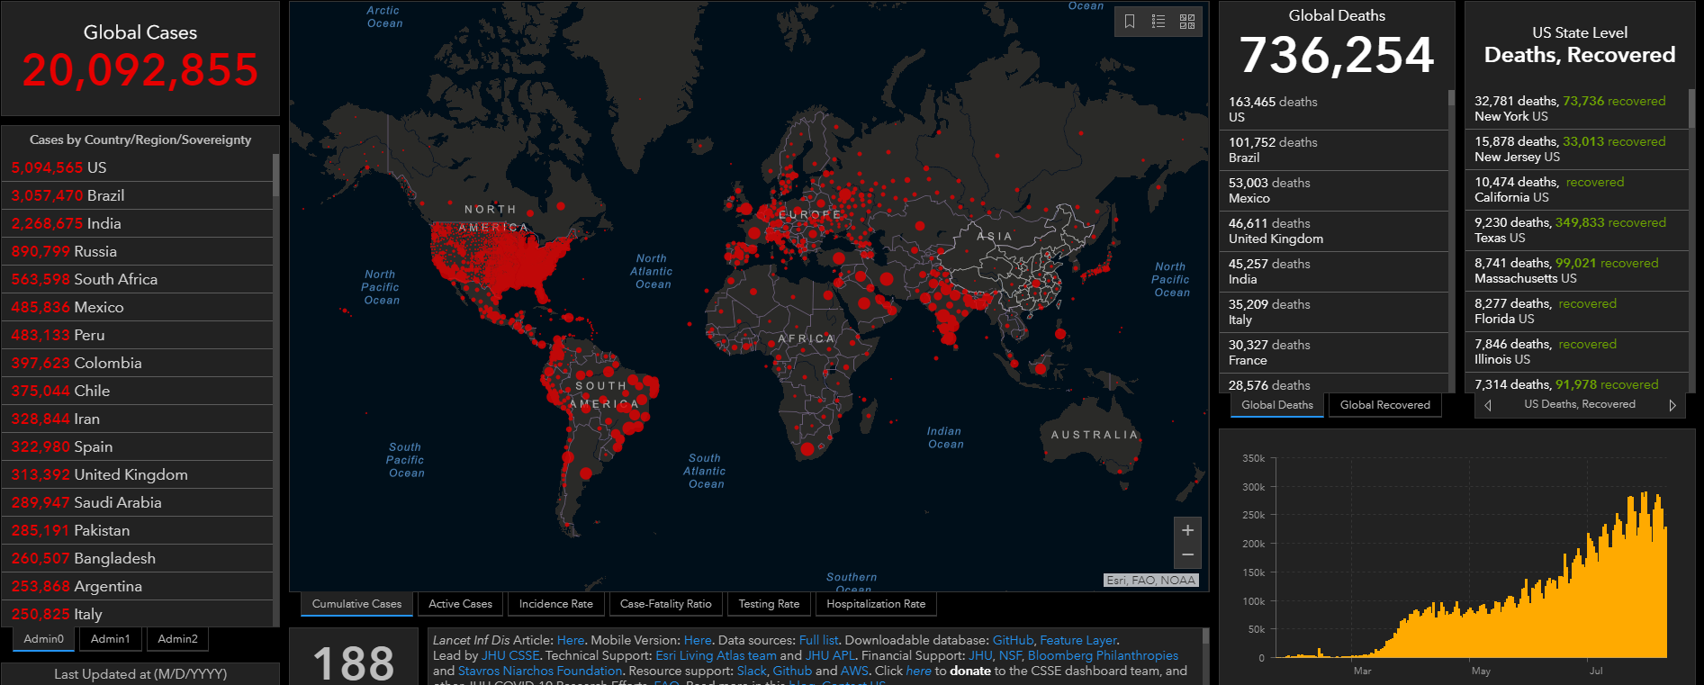
IMPACT OF COVID-19
Notes:
Over 20 million cases, over 700k death worldwide as of Aug 2020.
Every country was affected, in most ways, (economically, financially, socially etc.)

Slide 10
Methods
Details about data used
What we did to :
Gather/find data
Manipulate/wrangle data
Create new variables
Important variables and their summary statistics
Sample size

Slide 11
Results
This is the format that the results will take
the question
The Analysis used
What are the observations and conclusions from the tests done

Slide 12
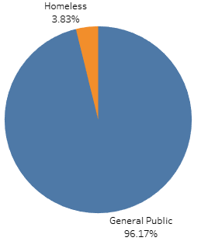
QN1: Are the homeless cases equal to the general public cases.
We ran a one proportional z-test
A one proportion z-test is used to compare an observed proportion to a theoretical one, when there are only 2 categories
The homeless cases are not equal to the general public cases. In fact that the homeless cases are only 3.8% of the positive COVID19 cases observed in San Francisco.

Slide 13

Not affected the same?!
How hard then did the homeless population get affect by
the covid-19 pandemic ?

Slide 14



QN2: How hard then did the homeless population get affect by the covid-19 pandemic ?
Online sources have stated that the homeless population was hit 80% harder compared to the general public in the last few months?
Is this true?

Slide 15
QN2: Online source has stated that the homeless population was hit 80% harder compared to the general public?
We ran Two Proportion z-test analysis.
Two Proportion z-test will determine the proportions of the cases in the 2 populations
so we can know the difference in percentage
We discovered that the homeless were impacted by 2.51% compared to its own population. And the general public were impacted by 0.71 compared to its own population.

Slide 16
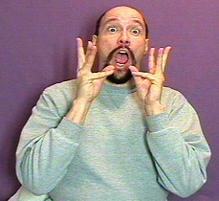
QN2: Online source has stated that the homeless population was hit 80% harder compared to the general public?
Using this tool @ https://www.calculatorsoup.com/calculators/algebra/percent-difference-calculator.php
we conclude that the Homeless population was hit 112% harder than the general public.

Slide 17
QN: Are the number of homeless cases affecting the general public. Are the homeless spreading COVID19 because they have no homes?
We ran linear regression predictive analysis.
Linear regression will be used to explain the relationship between the homeless population and the general public population.
We discovered that the homeless population was responsible for 96% of the spread of COVID19 to the general public. The 4% can be explained by other factors.
How ever, we found a lot of variance, the data was not evenly distributed.

Slide 18
QN2: Online source has stated that the homeless population was hit 80% harder compared to the general public?
First, We ran Goodness of Fit Chi-Squares analysis.
Goodness of Fit Chi-Squares will determine whether this percentage is true or not .
We discovered that this percentage isn’t even close to the real data.

Slide 19
QN: Have the rooms availability in the homeless shelters been affected by the covid cases in the county of San Francisco?
We ran Independent Chi-Square analysis.
Independent Chi-Square will determine whether “homeless cases" is influencing "rooms availability".
We discovered that as the homeless cases increased, the rooms availability decreased in the county of San Francisco especially in the later months of June and July.

Slide 20
Summary
Here is a summary of our discoveries :
Only 3.8% of COVID19 cases in San Francisco are homeless
2.5% of the homeless population has been affect by COVID19
Only 0.7% of the general public population has been affected by COVID19
Homeless population has been affected 111% harder than the general public
Towns that started out with fewer cases were faced wit an exponential growth in COVID19 cases
The homeless population are spreading COVID19 to the general public because they do not have homes and resources.

Slide 21
Conclusions
How do our finding impact the world at large ?
What’s important about this work?
Big picture information

Slide 22
QUESTIONS?

Slide 23
Sources
Coronavirus
https://www.cdc.gov/coronavirus/types.html
https://www.cdc.gov/media/subtopic/images.htm
https://coronavirus.jhu.edu/map.html

